Slide 1
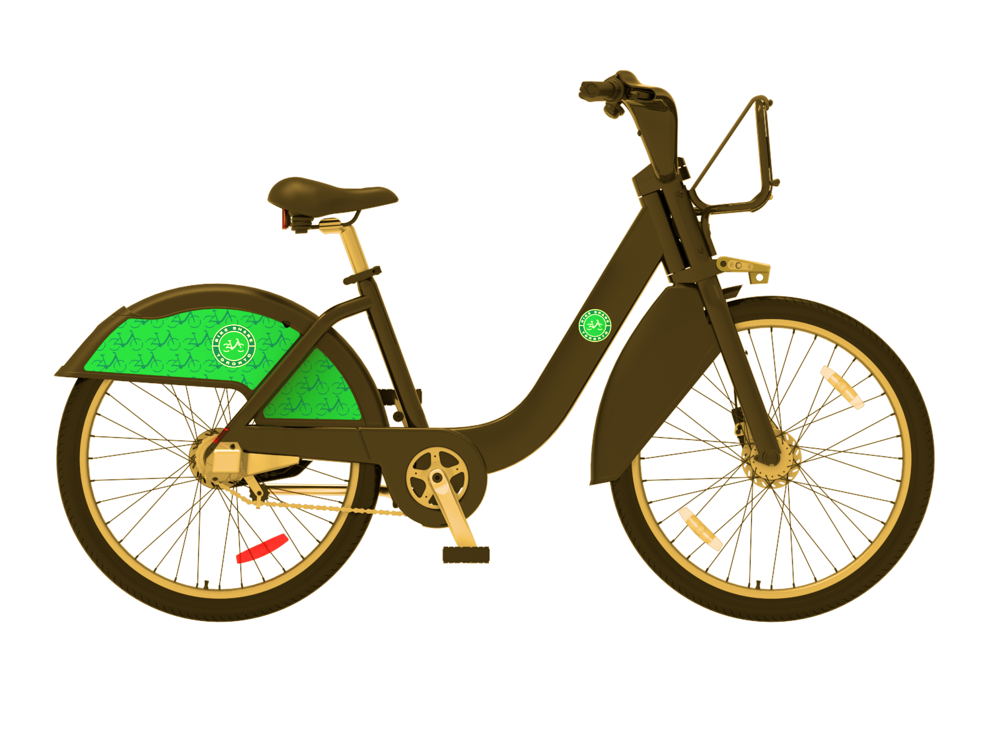
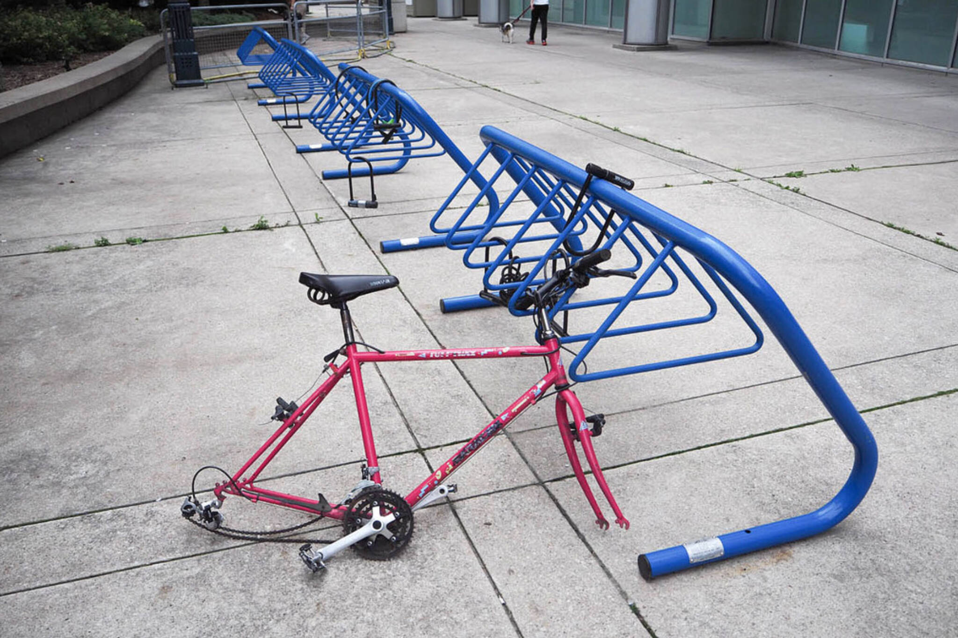
Modelling Toronto Bike Share Ridership and Bike Thefts for the city of Toronto
Saumya Verma
MS Computer Science
University of New Brunswick, NB

Slide 2
Problem statement
Client, City of Toronto, has approached EY to help rethink mobility in the metropolitan area.
Task :
Prepare a dimensional data model and analysis with the datasets provided by the client.
Explore status of the transportation network (bike paths, road network, public transit).

Slide 3
Project Summary
Provide Vital Information to understand the status of the transportation (the mobility of bicycle paths, Road network, Bike share ridership and thefts), its usage widely and determine necessary improvements.
Leveraged Data modelling and data analysis to study network and situation of bicycle ridership, station location , bike thefts and and road network to infer relations and suggest improvement points.
Report Outline:
Part 1: Data Loading
Part 2: Data Summary
Part 3: Data modelling
Part 4: Data Statistical Assessment
Part 5: Analysis

Slide 4
Part 1: Data Loading
Importing necessary libraries to process and visualize data.
Reading csv datasets :
Quarterly datasets of bike ridership of 2018
Bicycle Theft information
Bridge structure for road network
Reading geoJson dataset :
Bicycle station information of Toronto

Slide 5
Part 2: Data Summary
Statistical Analysis (min, max, avg, median, histograms) for the datasets used
Data information of columns for null, non-null values and data types
Identifying numeric data and categorical data features
Descriptive statistics of the dataset including and excluding non numeric columns

Slide 6
Part 3 : Data Modelling
Data Ingestion: Concatenating the same dataset of different time :
Quarter 1 ,2 , 3 and 4 of 2018
Data Type Analysis: Assigning the correct data types to the attributes.
Date-time feature extractions: Converting timestamp to meaningful attributes extracting day, time, date, day of week, month and time of the day.
Data Imputation: Adjusting to closest values for the station information, imputing missing values with mean/median/mode based on data spread
Feature Engineering: Creating new columns based on various aggregations /patterns identified (eg. Mor, Noon, Eve, Night instead of hours)
Taking out only relevant columns of the station information table : station_id, name, latitude and longitude
Data Aggregation: Grouping bike theft data by bike type and status
Imbalances Classes management during prediction modelling (Random Oversampling technique used)

Slide 7
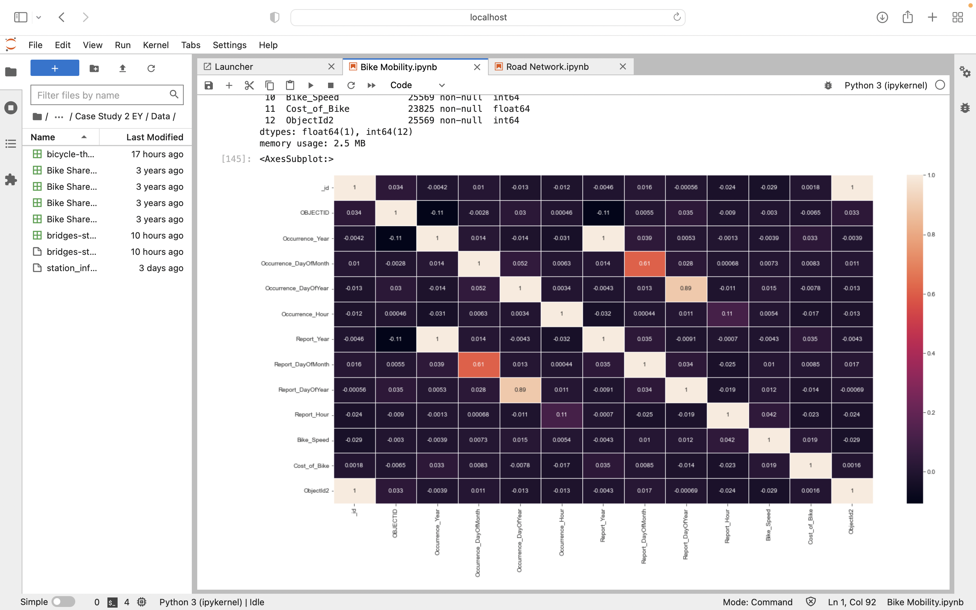
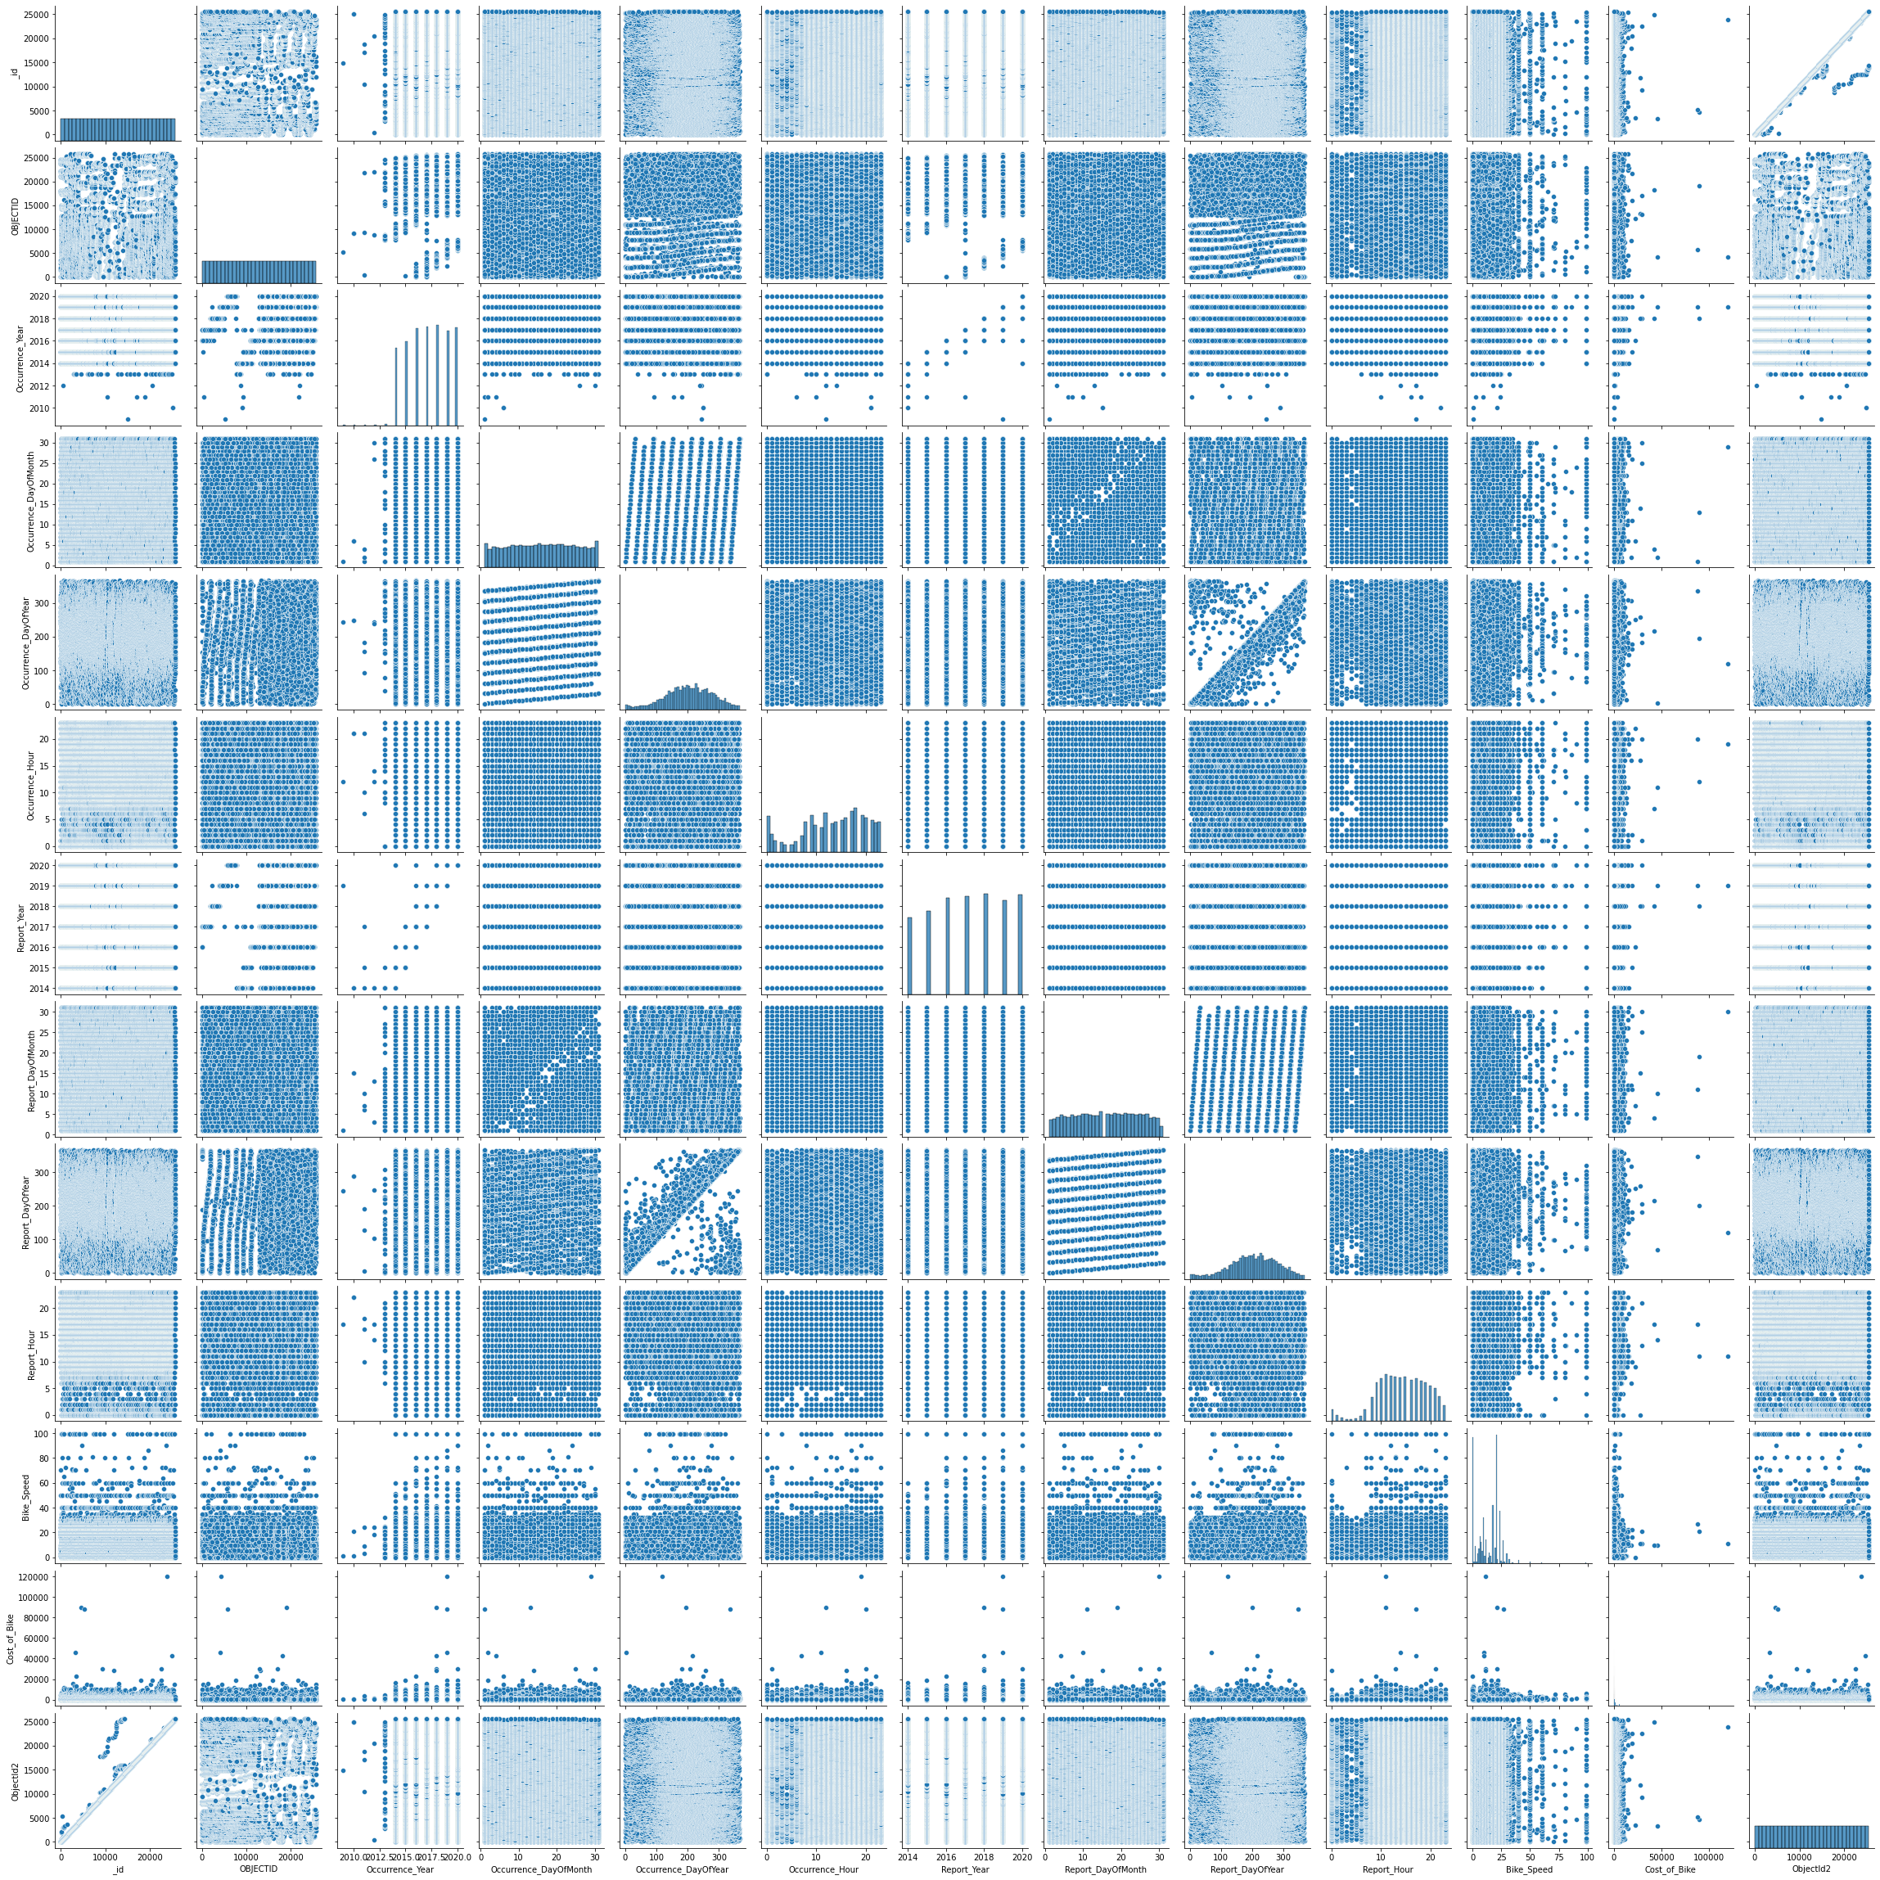
Part 4: Data Statistical Assessment
Heat Map: Correlation study between the features of Bike Thefts in Toronto City
Statistical Analysis of the features
Strong correlation between time start and time stop for bike ridership
Strong correlation between Occurrence year and reports in the year for the bike theft model
Negative correlation between time start and from station and year to day or month for bike theft
Moderate relation between Occurrence hour and report hour

Slide 8
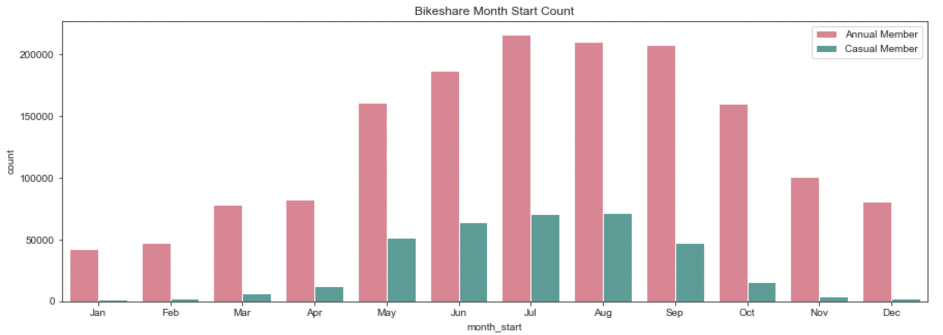
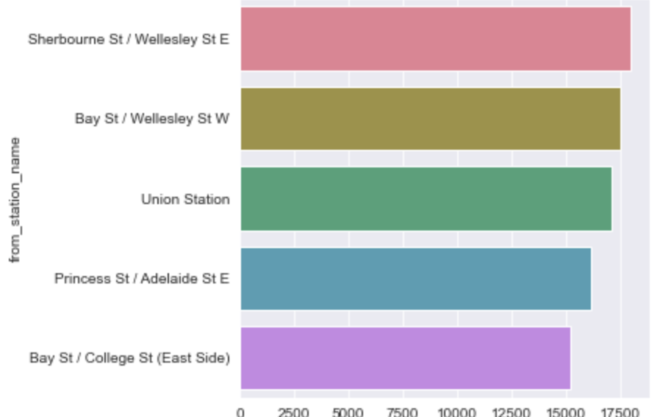
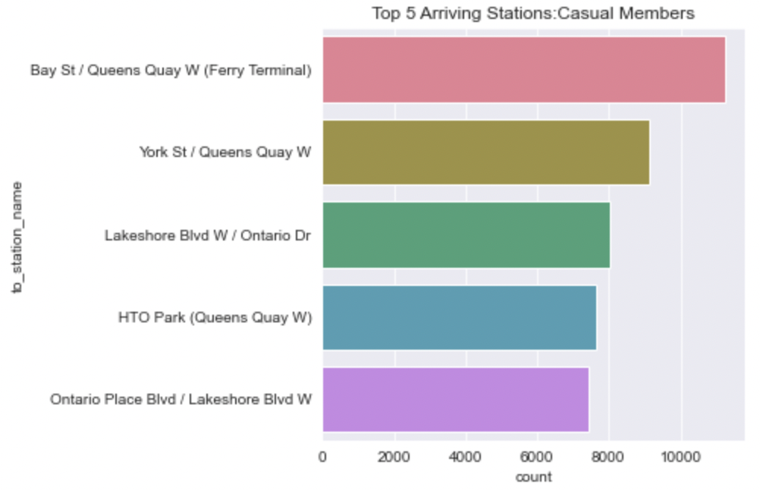
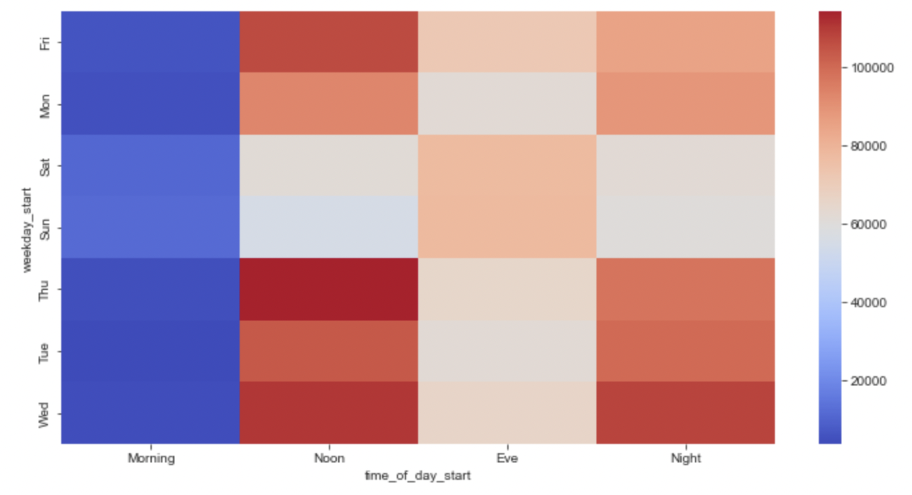
Part 5: Analysis
Bike ride over the months for the year of 2018 giving insights over the number of rides over the months
Bike share monthly usage trend by Annual and Casual Members
Top 5 Departing Stations by the members
Top 5 Arriving Stations by the members
Bike rides by Annual and Casual members are maximum during summers (May-Sep) with July being the highest rideshare day
The stations which had the maximum starting points for the rideshare was Sherbourne St/Wellesley St E
The station which had the maximum rideshare end points were Bay St/ Queens Quay W (Ferry Terminal) which means customers prefer the usage convenient towards Ferry Terminal
Least usage hours are the morning hours, and peak usages are on Wed-Thurs-Friday Noon and Wednesday Night with moderate use in evening hours on all days
Bike share by time of the day

Slide 9
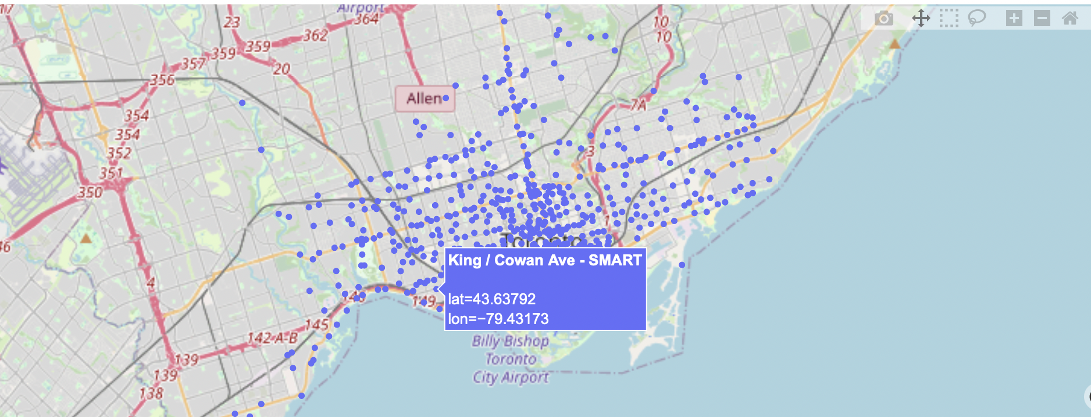
Part 5: Analysis
?

Slide 10
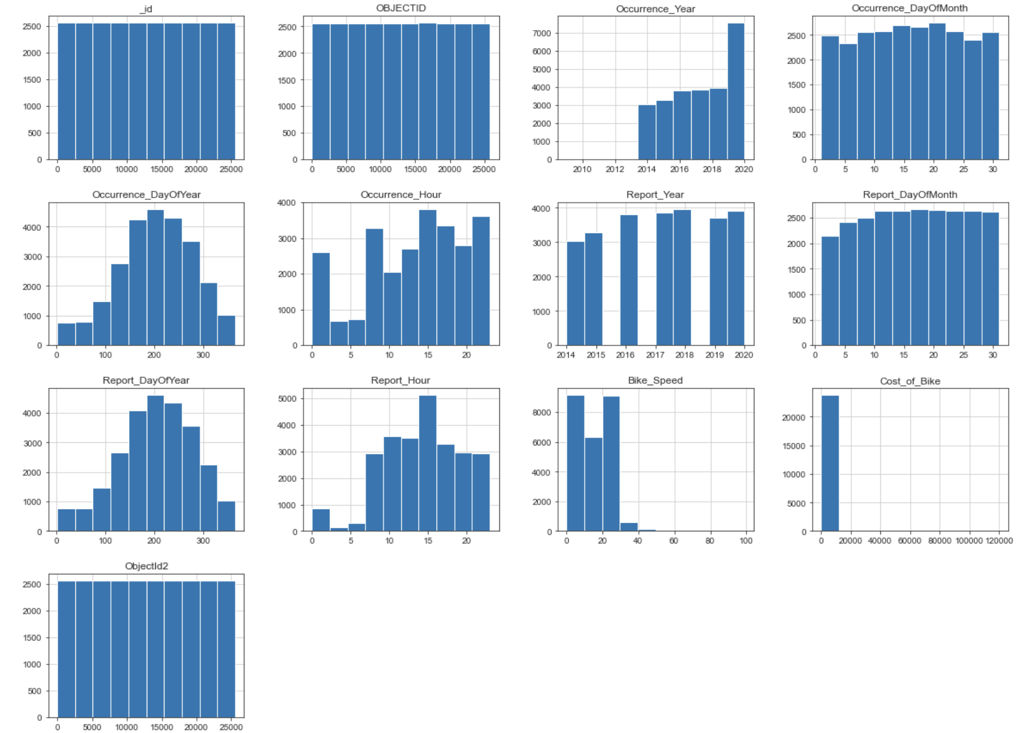
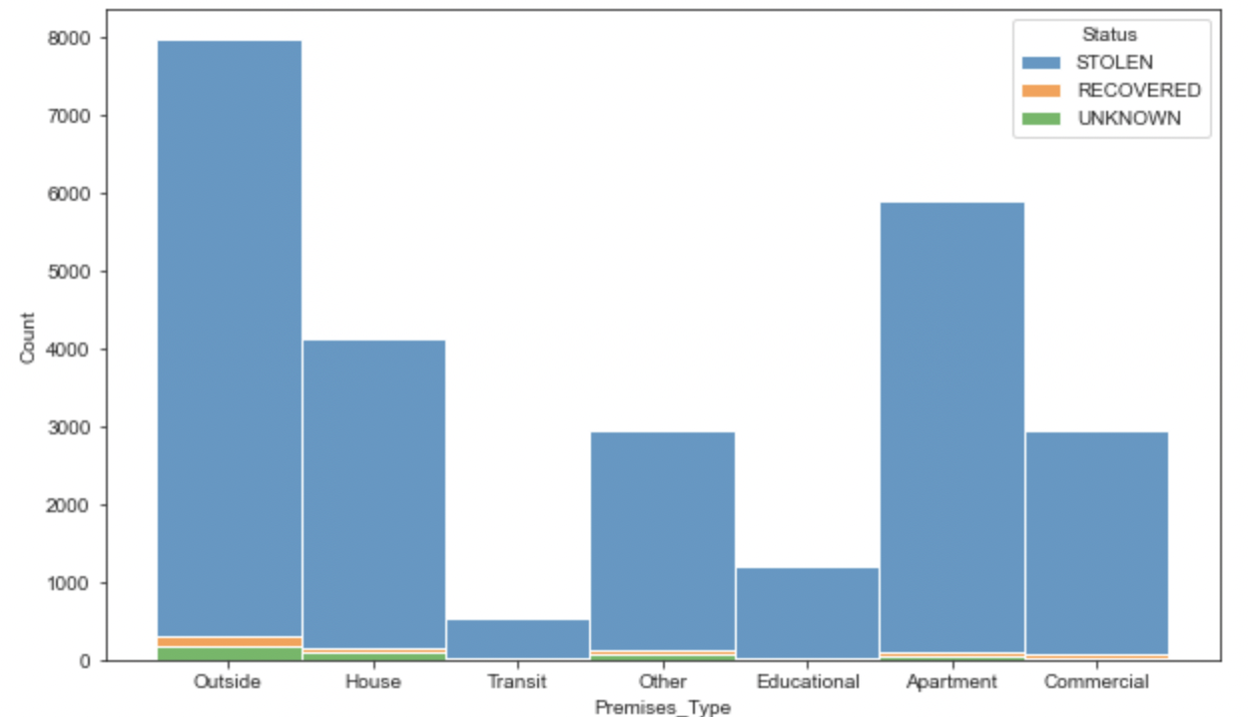
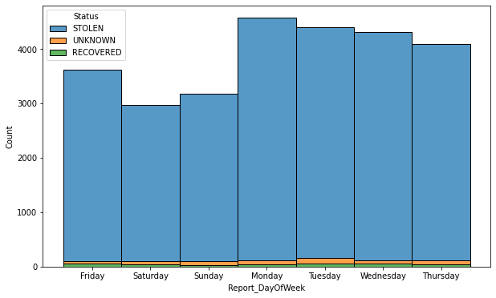
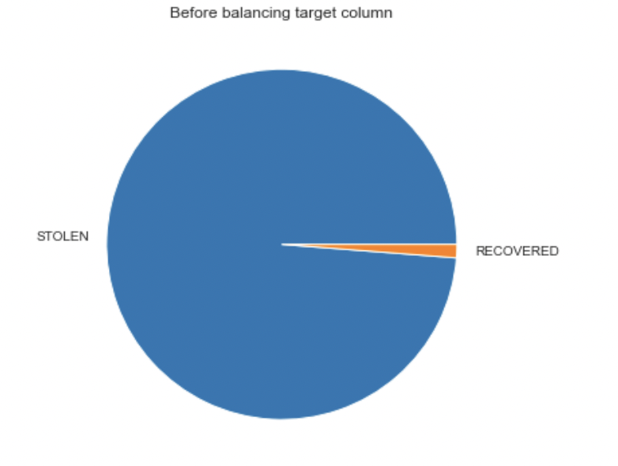
Part 5: Analysis of Thefts
Statistical Analysis of the attributes and the imbalance in the target column identification to address data imputations
Maximum thefts reported from Outside, Apartments, and Houses. Maximum recovery percentages of the thefts were from Outside. The least thefts reported from Transit and Educational institutions
Less number of reports during weekends compare to weekdays
Incidences are at the peak in middle of the year during summer, starts to drop during fall and picks up again after spring

Slide 11
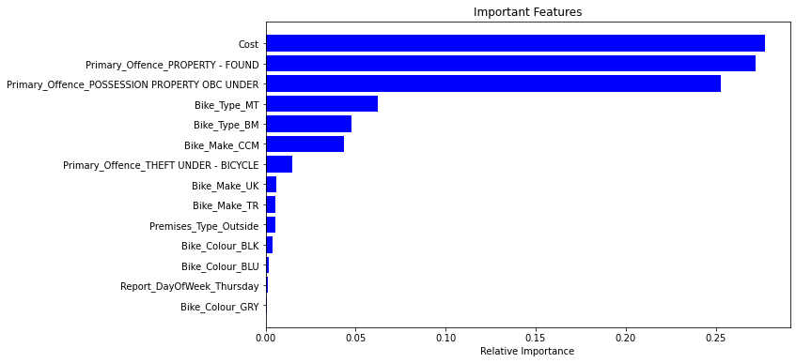
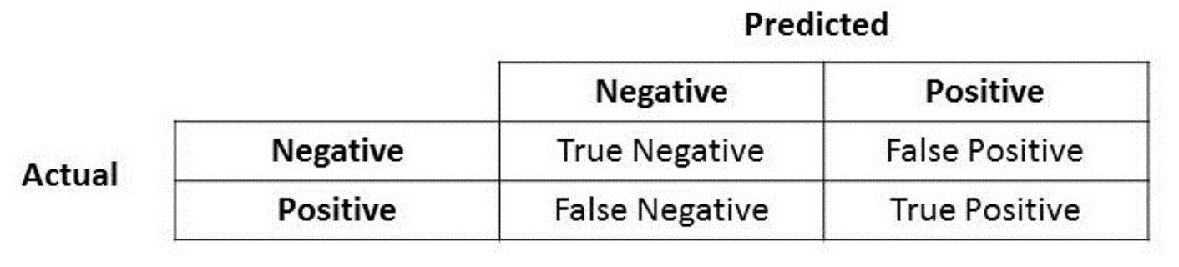
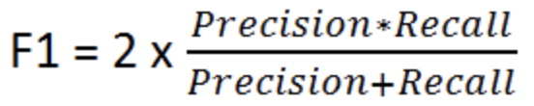
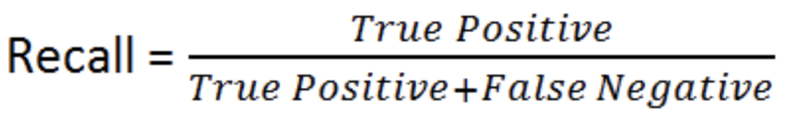
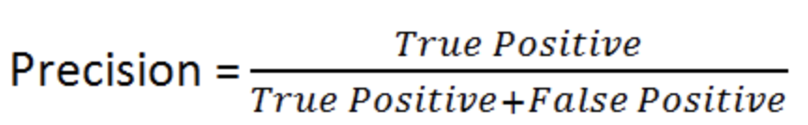
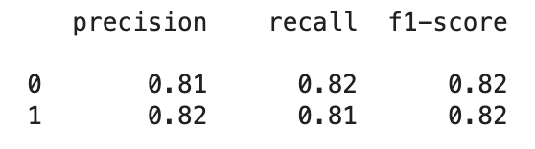
Part 5: Steps for Prediction Model for Theft recovery
Managing Imbalanced Classes: Balancing the target column using the technique random oversampling of minority class (Status=RECOVERED)
Data Imputations of Null Values based on statistical analysis results
Data Pipelining: Pipelines class to streamline all the pre-processing transformations and creating a numeric pipeline for scaling the numeric data and one-hot encoding of categorical features
Train Test Split used: 80:20
Input Attributes: 'Primary_Offence’, 'Occurrence_DayOfWeek’, 'Report_DayOfWeek’, 'Hood_ID’, 'Bike_Make','Bike_Type’, 'Bike_Colour', 'Location_Type', 'Premises_Type’
Modelled using Logistic Regression , Support Vector Machine classifier, Decision Tree and Random Forest Classifiers – Best precision (true positive accuracy)
Fine tuning Parameters: Performed both grid search and randomized search but decided to go with grid search as it would thoroughly go through all the possible combinations to provide best parameters

Slide 12
Future Work
Create pipelining with data loading, streaming and analytics
Improvising Predictions : use deep learning
Saving the model , build automated pipeline

